Slide 1
Addressing the Spectrum of Prevention
Notes:
Let’s take a few minutes to ground ourselves in the ‘big picture’ of prevention. We call it the ‘spectrum of prevention’

Slide 2
What is the spectrum of prevention…?
Notes:
This graphic illustrates what we mean by the ‘spectrum of prevention.’ [NOTE: YOU SHOULD HAVE A COPY OF THE GRAPHIC AS A HANDOUT SO PEOPLE CAN READ THE DETAILS]
You can see that there are 5 levels in the spectrum – societal, community, organizational, interpersonal and individual.
The big idea here is that children and youth are influenced toward healthy or not-so-healthy development by many levels of life!
Individual factors play a role (like temperament, attitudes, and beliefs)
At the relationship or interpersonal level, we’re looking at how parents relate with their children or how young people interact with each other, and how this could influence a young person’s decisions.
At the organizational level, we think for example about how a school’s policies, procedures, and decision-making might impact youth development. As we get to this level, we consider the kinds of norms that are being modeled in places where youth frequent.
At the community level – what kind of community does this young person live in? Is it supportive of his/her/their unique development?
And at the societal level – what are the systems and policies in place? Do they support youth development– for all youth, not just a few -- or hinder it in some way?
The good news is: we can do high quality, effective prevention work at each of these levels.

Slide 3
…And why are community-level prevention strategies important?
Notes:
So, given that there are 5 levels of influence on our behaviors, why might community-level prevention be important?
Please keep this question in mind, as we tell a story that might illustrate an answer for you.

Slide 4
Hi! I’m Mia.
Notes:
The following tells a story about how these 5 levels of influence might relate to how youth might make decisions.
Here’s Mia.

Slide 5
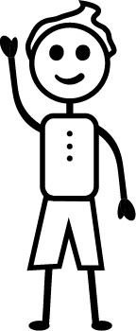
Hi! I’m Mia’s friend, Alex.
Notes:
Here’s Mia’s friend, Alex.

Slide 6
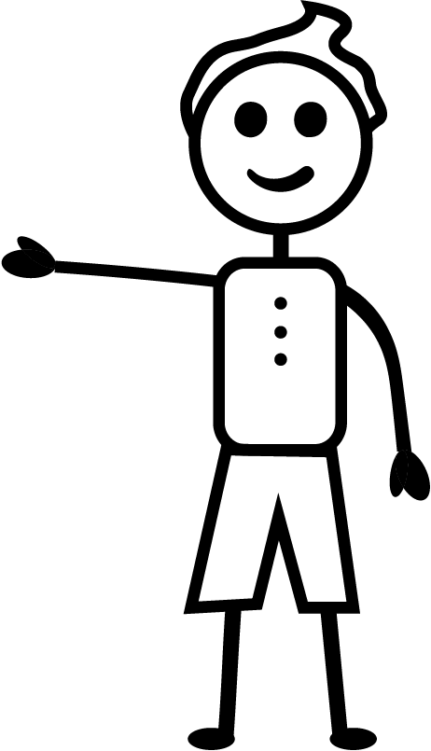
Mia, do you want to smoke some pot?
Notes:
Alex asks: Mia, do you want to smoke some pot?

Slide 7
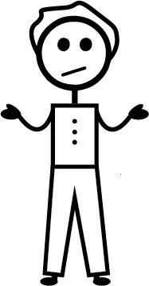
What influences Mia’s decisions to smoke pot with Alex?
What should I do?
Notes:
As Mia is thinking how to respond, let’s think about how these 5 levels of life might influence her decision …

Slide 8
Mia Herself?
Mia might think marijuana is cool, and maybe she’s a risk taker…
Notes:
[Read the slide.]
Ask the question: Which level of the spectrum of prevention would this be on?
[The answer is: individual level]

Slide 9
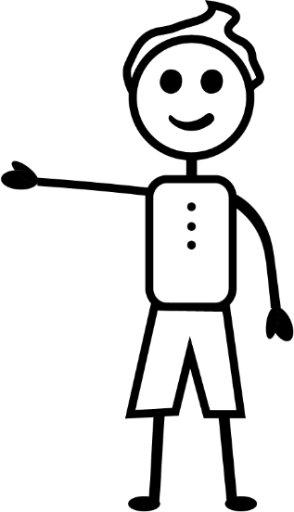
Her friends like Alex?
Mia might have friends who use marijuana, and they might influence her to try it…
Notes:
[Read the slide.]
Ask the question: Which level of the spectrum of prevention would this be on?
[The answer is: interpersonal level]

Slide 10
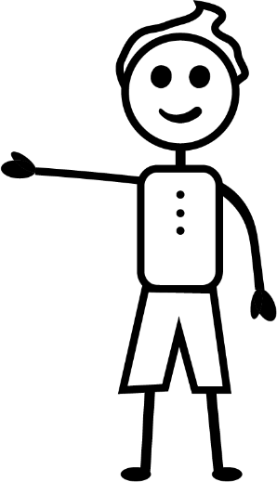
Her family?
Mia may not have a lot of rules at home, her family might argue a lot, or they might use marijuana around her…
Notes:
[Read the slide.]
Ask the question: Which level of the spectrum of prevention would this be on?
[The answer is: interpersonal level]

Slide 11
Her school?
Mia might not feel welcome or safe in her school, and she may even get bullied by classmates…
Notes:
[Read the slide.]
Ask the question: Which level of the spectrum of prevention would this be on?
[The answer is: organizational – school safety, interpersonal - bullying]

Slide 12
The health system?
Mia might get a physical exam every year, but she’s never asked if she feels sad, hopeless, or isolated, even though she does…
Notes:
[Read the slide.]
Ask the question: Which level of the spectrum of prevention would this be on?
[The answer is: organizational level]

Slide 13
Businesses in her town?
Mia’s caretakers might work in town, but they don’t receive paid time off, so they can’t always make it to Mia’s important school events because they need to make money and put food on the table…
Notes:
[Read the slide.]
Ask the question: Which level of the spectrum of prevention would this be on?
[The answer is: organizational level]

Slide 14
Laws and policies?
Mia may have been served a beer at a bar once because the bartender didn’t ask for her ID, even though she is underage…
Notes:
[Read the slide.]
Ask the question: Which level of the spectrum of prevention would this be on?
[The answer is: community – policies in place, laws being (or not being enforced) – so setting norms that substance use is acceptable; organizational – business not supporting youth substance use prevention]

Slide 15
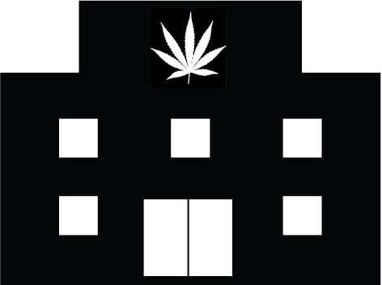
Access to substances?
Mia’s school is a block away from a pot shop, and she walks past it every day. Plus, Mia knows her older brother uses marijuana…
Notes:
[Read the slide.]
Ask the question: Which level of the spectrum of prevention would this be on?
[The answer is: interpersonal – brother uses; community – norms of walking by the pot shop means it is something that Mia thinks it is normal to have in her town, and people must use]

Slide 16
Social norms?
Mia sees people using marijuana in her community and on social media all the time…
Notes:
[Read the slide.]
Ask the question: Which level of the spectrum of prevention would this be on?
[The answer is: community level]

Slide 17
So what will Mia do?
Will she decide to smoke pot or not?
And what can WE do, as the prevention champions in our community, to set things up to help her make a good decision?
Notes:
Here we will pause in Mia’s story and think of it is an example of how we can think about our youth and our role in supporting their positive development – how can WE, as the prevention champions in our community, set things up to help all of our youth make a good decision?

Slide 18
If we address prevention efforts at the individual level…
…we could focus on individual programs to educate and build skills for youth to support positive decision-making and behaviors.
Notes:
[Read the slide.]

Slide 19
Examples?
Notes:
[Ask the group for other programs they know of… just one or two examples.]

Slide 20
If we address prevention efforts at the interpersonal level…
…we could focus on individual programs to educate and build skills for parents to improve their relationships and communication with their kids.
Notes:
[Read the slide.]

Slide 21
Examples?
Notes:
[Ask for other examples… just one or two.]

Slide 22
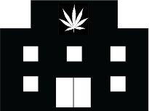
And … if we also address prevention efforts at the community level…
We can address the entire spectrum of prevention by building public support and impacting the support systems throughout the community, school, family, and individual levels.
Notes:
[Read the slide then state:]
We can do work like this with our highly engaged CTC coalition, as we can provide the momentum to create lasting community change.

Slide 23
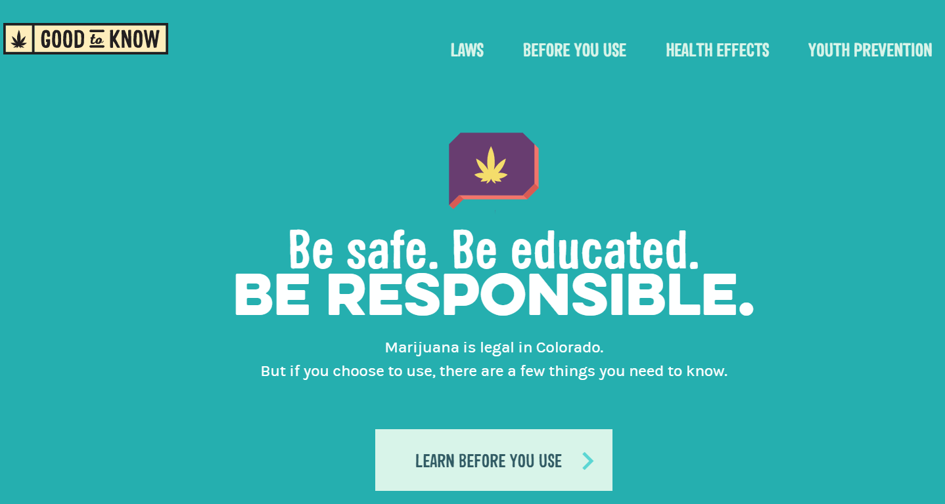
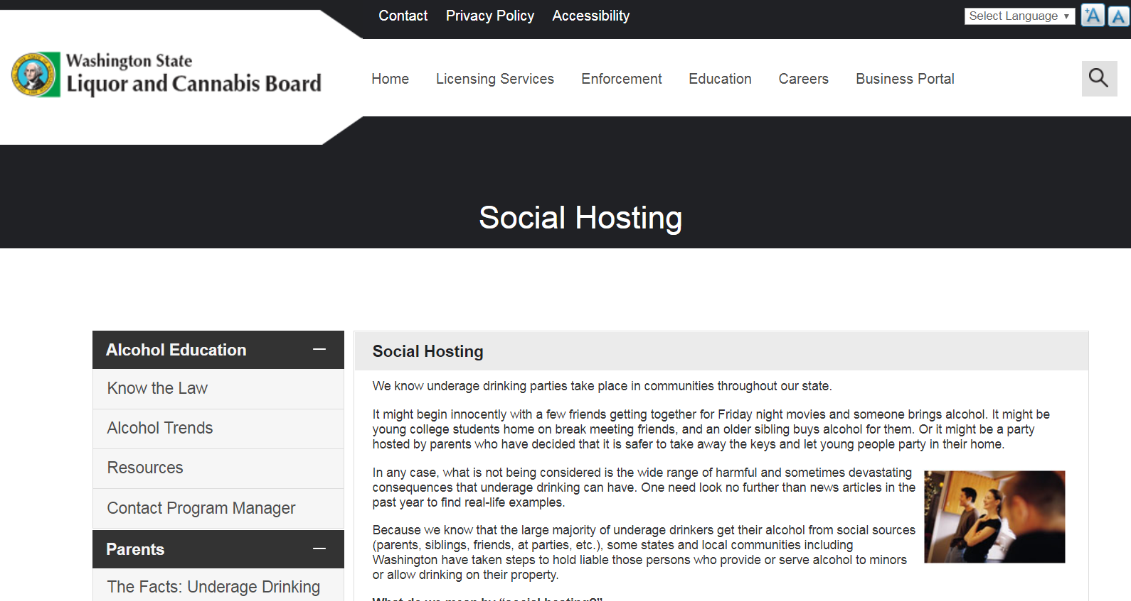
Examples?
Notes:
One example is enacting a local social host ordinance that makes it clear that it’s illegal to provide alcohol/drugs to underage people, even for underage guests in our own homes, and that there are consequences to families who might do so.
Another example is to have a public media campaign that shares messages to help shape norms in the community, such as the Good to Know campaign, which provides education about marijuana.
What might be some other examples at the community level?

Slide 24
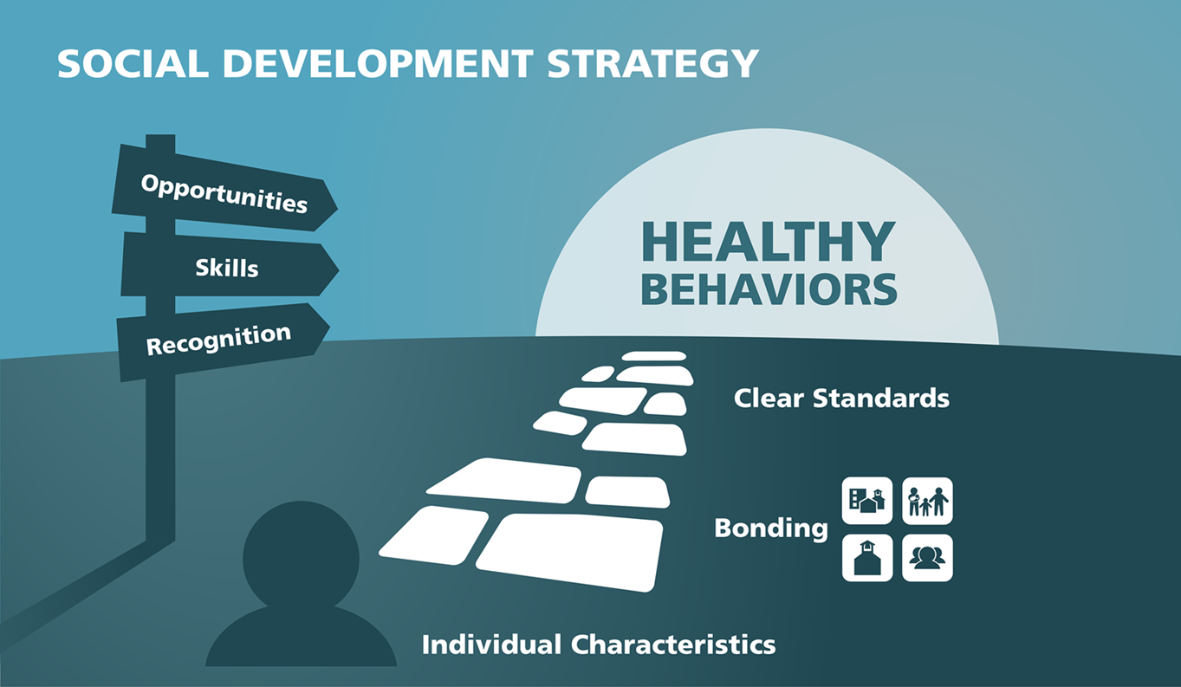
Do quality prevention AND build bonding!
We can address the spectrum of prevention AND also put efforts in place to build youth’s sense of bonding and attachment.
Notes:
We can also change the way adults perceive and interact with young people, which is an important component of building young people’s sense of belonging and bonding in our community.
Utilizing the social development strategy in our community would help us to provide the opportunities for youth, help them build skills to succeed in those opportunities, and to recognize them for their engagement and contributions. This would help increase their bonding to the community --- bonding or attachment provides the motivation to follow community guidelines or norms -- and we would continue to communicate clear and consistent standards and norms for their behavior.
Additionally, incorporating positive youth development approaches into how our organizations function would allow us change the environment in local organizations to be more welcoming to youth, and also focused on to helping youth acquire the knowledge and skills they need to become healthy and productive adults. In addition, the PYD/SDS approach would lead to equitably capturing youth voice and direction in the creation and implementation of programs and services meant to benefit youth.
If we did this broadly across the community, and really changed the norm of how adults interact with and empower youth, do you think this could be a shift in how our community currently works? [Ask for comments/thoughts.]

Slide 25
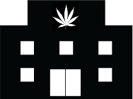
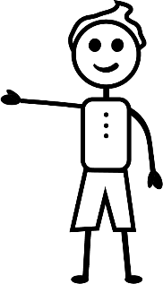
So, when Mia feels positively supported by her community, school, family, and peers, and has the skills to stay out of trouble AND keep her friends…
Notes:
So we return to Mia’s story. If we have effectively done our prevention work across the spectrum, have we helped youth like Mia to make healthy choices?

Slide 26
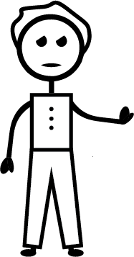
Mia has no problem saying “no”.
No thanks! How about we…?
Notes:
Mia subsequently has the skills to say no but still keep her friends (like in this slide, she’s not rejecting her friend she’s just suggesting something else that would be fun to do together)

Slide 27
What example do you have of a program, or community-level prevention strategy that had an impact on your life or decision making?
Notes:
Presenter, be prepared to start this conversation by sharing an example from your own life.
Then get the group into pairs or triads to discuss this question amongst themselves.
Once they’ve had a good conversation, ask for 1-2 brave souls to share their examples.

Slide 28
Three Big Questions
What’s happening related to our priority risk and protective factors? What potential programs or community-level strategies exist?
How well are these programs or strategies working? What are the strengths and limitations?
How can our coalition enhance this prevention work?
Notes:
So now, as we embark on our resources assessment, here are the key questions we’ll consider.
[Read the slide.]
[Note to presenter – if you are using this powerpoint outside of the Phase 3 resource assessment, you can eliminate this slide.]

Slide 29
The End Game
Make recommendations to fill gaps in our systems:
Bolster existing efforts
Add new best practices
Prepare findings and recommendations for the full Community Board for the Community Planning Workshop
Notes:
Here are the goals of our resources assessment.
[Note to presenter – if you are using this powerpoint outside of the Phase 3 resource assessment, you can eliminate this slide.]

